Slide 1







Identifying current and future IT skill requirements
Cliff Siu
April 2023

Slide 2



OUTLINE
Executive Summary
Introduction
Methodology
Results
Visualization – Charts
Dashboard
Discussion
Findings & Implications
Conclusion
Appendix

Slide 3

EXECUTIVE SUMMARY
We are using the subset of the online survey conducted by stack overflow
Finding different insights from the technology trends in a current and future year.
Python is getting more popular
More developers are using NoSQL technology
USA is the country dominant in the IT industry
Major of the despondences are from the age 24-36 and men
Trends in different languages, platforms, and database

Slide 4

INTRODUCTION
Technologies are rapidly increasing in the recent decade
Goals of the Presentation is to identify the current and future skills IT skill requirements
Finding the most demand from various sources from:
Job postings
Training portals
Surveys
Analyzing and identify insights and trends from the following:
Top programming languages in demand
Top database skills in demand
Popular IDEs
Audiences: Developers, IT leaders, educators, and IT students

Slide 5

METHODOLOGY
Data Source: Subset of an online survey from Stack Overflow with ~90,000 responses (link) in 2019
Data Wrangling: Removing duplicate values and handling missing values
Data Analysis: Identifying the distribution, outlier, and correlation in the data set
Data Visualization
Python
IBM Cognos
Share Result

Slide 6
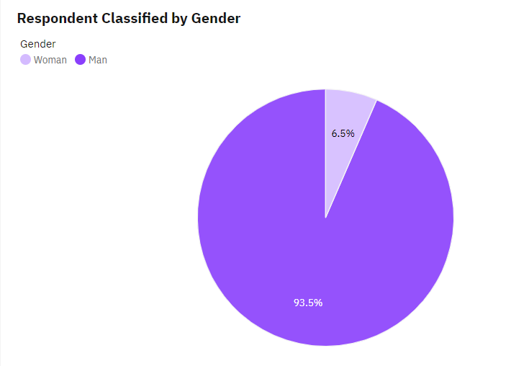
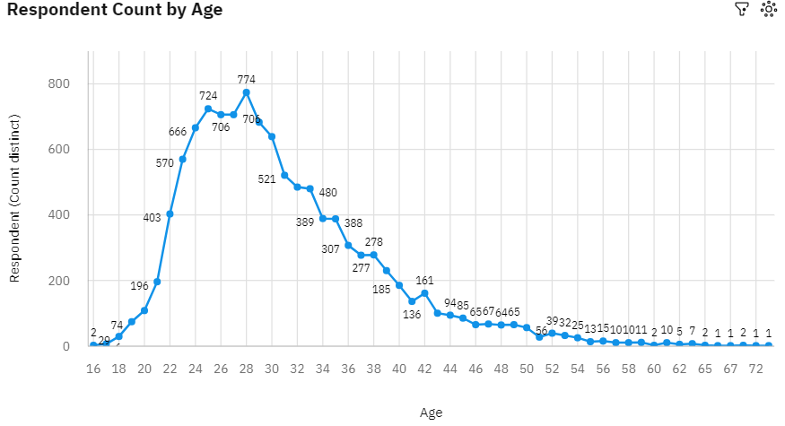
RESULTS
In the survey, the majority (>90%) of the respondents are Men in the Tech industry
Most of the respondent has an age between 22-34

Slide 7
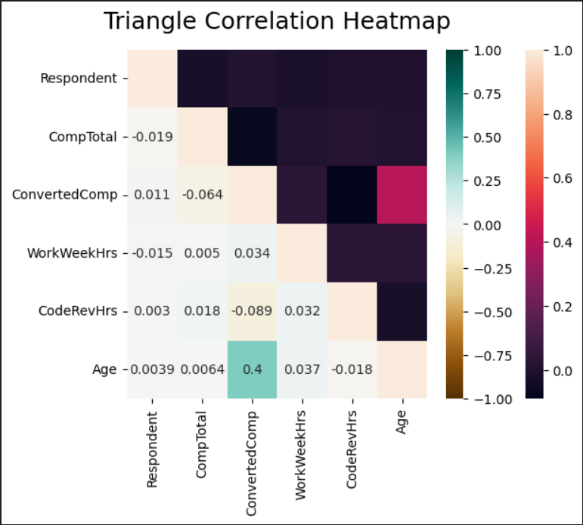
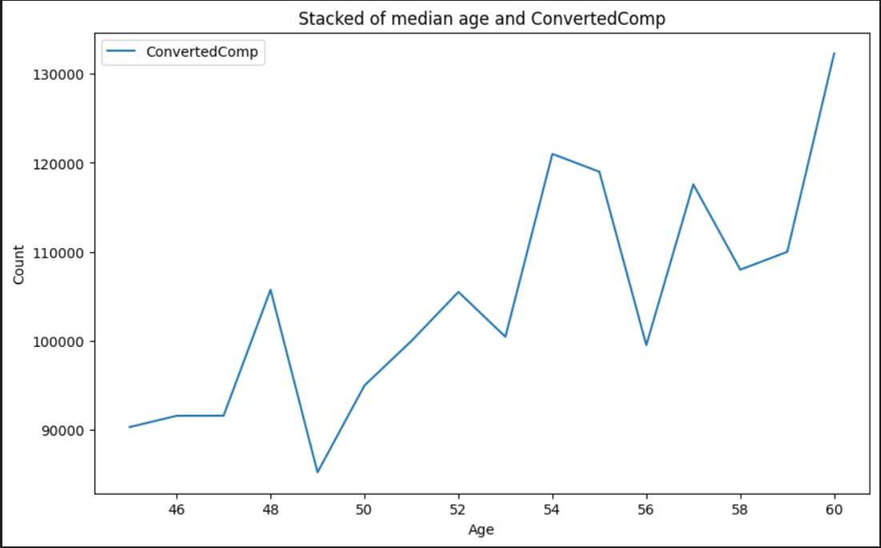
RESULTS
There is no correlation between any two features. However, there is some positive correlation between age and Convertedcomp ( Annual salary in USD)
As the age increase, the annual salary will also increase.

Slide 8
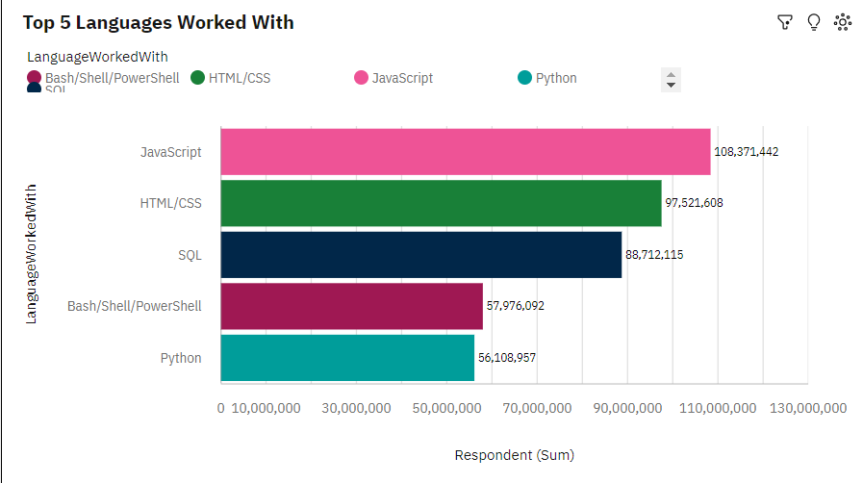
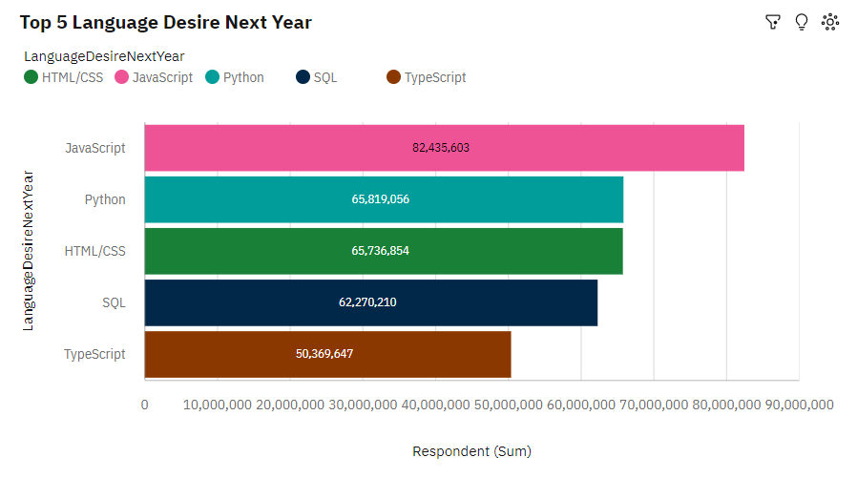
PROGRAMMING LANGUAGE TRENDS
Current Year
Next Year

Slide 9
PROGRAMMING LANGUAGE TRENDS - FINDINGS & IMPLICATIONS
Findings
JavaScript is the top 1 in both current and future trends
Python and TypeScript will become more popular in the future
PowerShell/ Bash becomes less popular
Implications
JavaScaript is still in high demand; however, python and typescript may take over in the future
SQL remains the same trends for big data querying and storage
Python is becoming popular with developers due to its AI, ML, and big data flexibility.

Slide 10
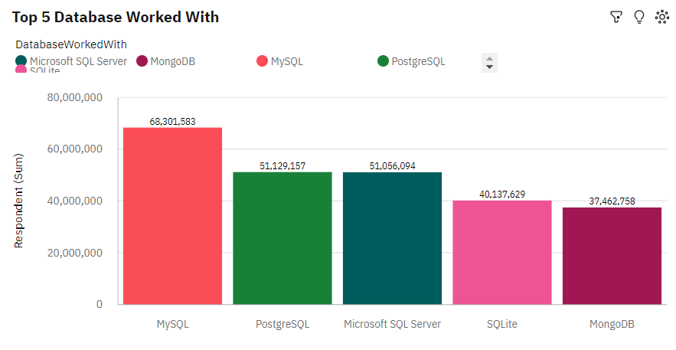
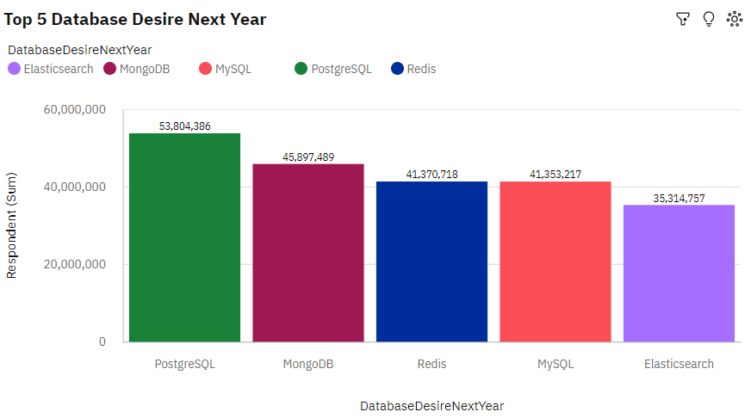
DATABASE TRENDS
Current Year
Next Year

Slide 11
DATABASE TRENDS - FINDINGS & IMPLICATIONS
Findings
MySQL & Microsoft SQL Server are getting less popular
MongoDB and Redis become more popular for NoSQL database
The popularity of PostgreSQL remains the same in both current and future
Implications
There is an increased preference for open-source database
NoSQL database is getting more popular in the future due to the amount increase in non-relational and unstructured data
SQL is skill required in Big Data field

Slide 12

DASHBOARD
The following link contains current and future technology trends, and Demographics based on the online survey from Stack Overflow.
https://github.com/Cliffsiu/IBM-Data-Analyst-Capstone-Project/blob/main/w5%20project.pdf

Slide 13
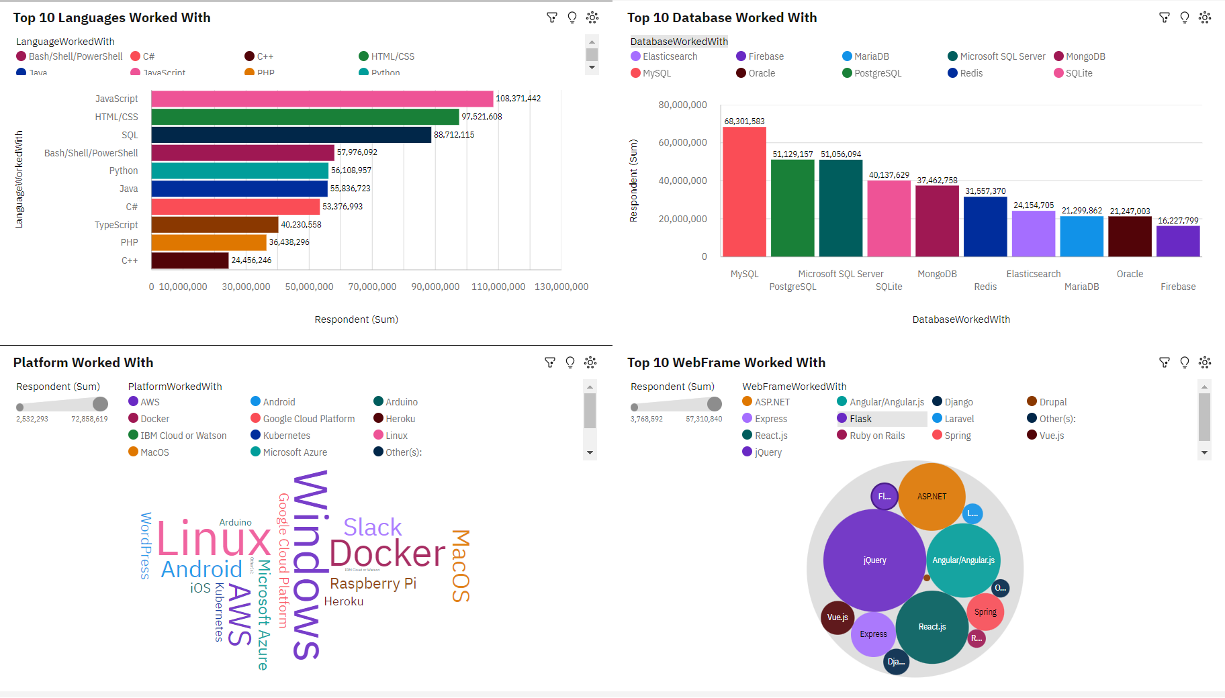
DASHBOARD TAB 1

Slide 14
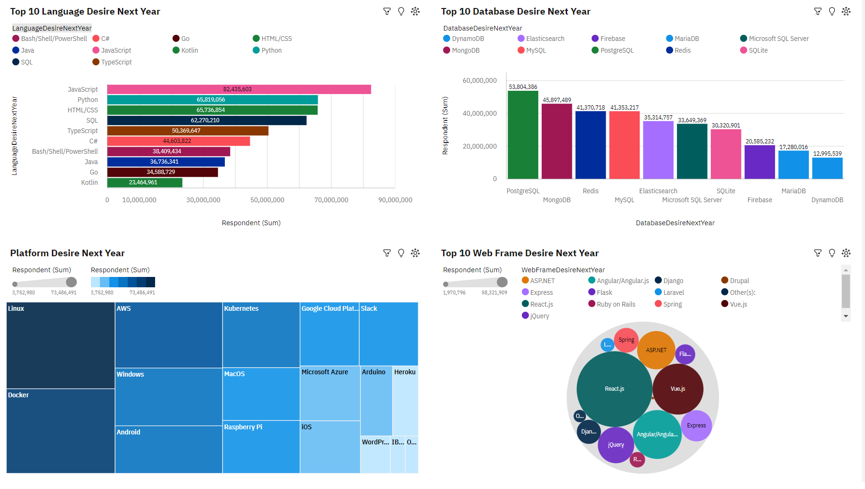
DASHBOARD TAB 2

Slide 15
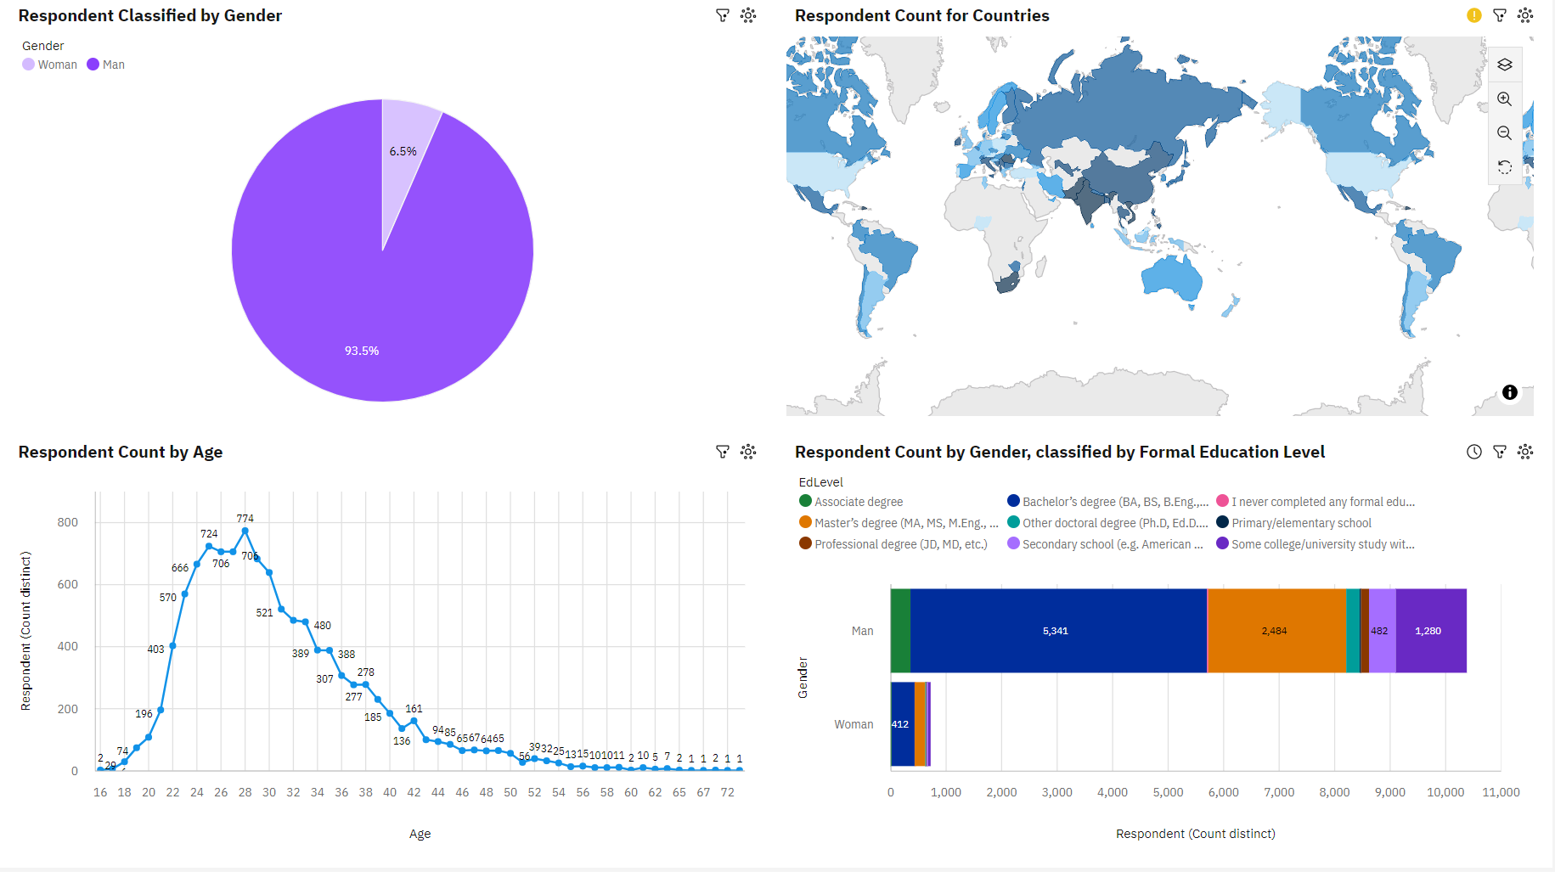
DASHBOARD TAB 3

Slide 16
DISCUSSION
The technology trend in the current day and in the future
The impact of gender, age, education level, and living country.

Slide 17
OVERALL FINDINGS & IMPLICATIONS
Findings
Technology always changing every year.
USA is the country dominant in the IT industry
IT industry is more toward to the men and young
Implications
Developers need to be adept in new environments and technology all the time
More countries should be exposed to new technology
The is a huge gap in gender and age, employers should not be judged by these feature

Slide 18

CONCLUSION
A subset collected data from Stack Overflow online survey in 2019
Finding different insights from the technology trends in a current and future year.
Insights from demographic trends
Different in gender and age
Trends in different languages, platform, and database

Slide 19

APPENDIX
Include any relevant additional charts, or tables that you may have created during the analysis phase.

Slide 20
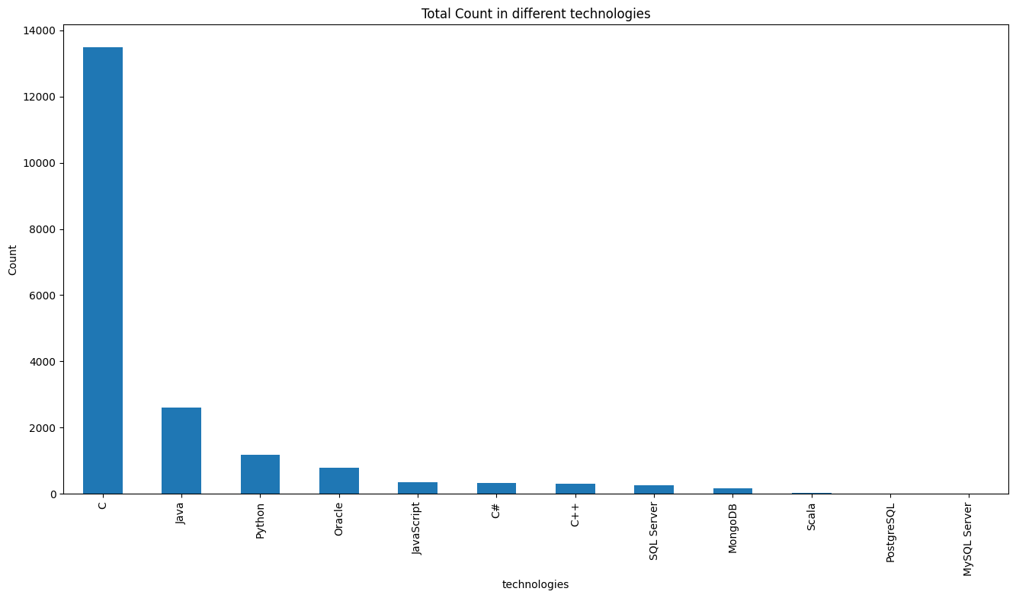
APPENDIX A: JOB POSTINGS

Slide 21
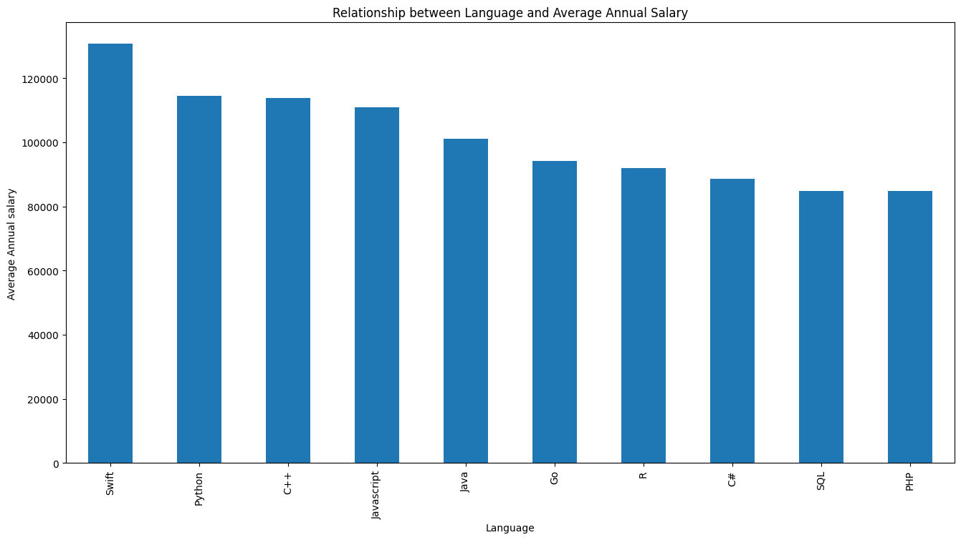
APPENDIX B: POPULAR LANGUAGES

